Slide 1

High-Performance 2-bit Magnitude
Comparator Using Hybrid Logic Style
Department of EEE,
Ahsanullah University of Science & Technology

Slide 2
Project Group Information
Project Group
Sharaf Joaher Khan
Rifat Bin Arif
Md.Ekramul Hasan Sharon
Hashin Israq
190205178
190205182
190205183
190205184

Slide 3
Table of Contents
Introduction
Circuit-1(A is greater than B)
Circuit-2(A is equal to B)
Circuit-3(A is less than B)
Comparison Table

Slide 4
Introduction
What is comparator
A comparator is a circuit that compares two voltages and outputs a digital signal indicating which voltage is higher. The two input voltages are usually referred to as the "inverting" and "non-inverting" inputs, and the output of the comparator is typically a digital "high" or "low" signal, depending on which input is higher. Here we used High-Performance 2-bit Magnitude
Comparator Using Hybrid Logic Style.
Uses of Comparator
The comparator is commonly used in electronic circuits for a variety of applications, such as analog-to-digital converters, oscillators, and power management circuits. It is also an essential building block for operational amplifiers, which are widely used in many electronic systems.

Slide 5
Circuit-1
Circuit-1
A is grater than B
Here the first circuit does the job of comparing magnitude of A & B and gives the result if A is greater than B.
In the out put section it is seen that if A is really greater than B then in output it will show 1. Other wise it will show 0 in all other cases.

Slide 6
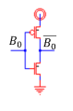
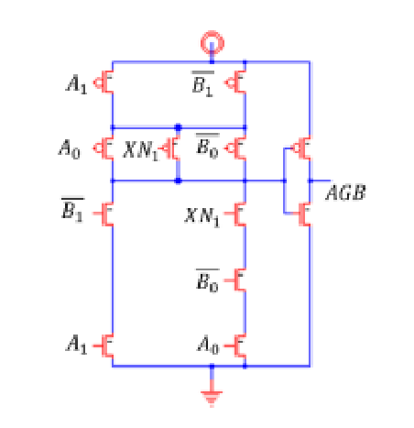
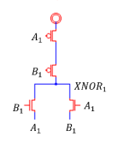
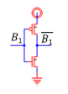
A is greater than B
Circuit Diagram :

Slide 7
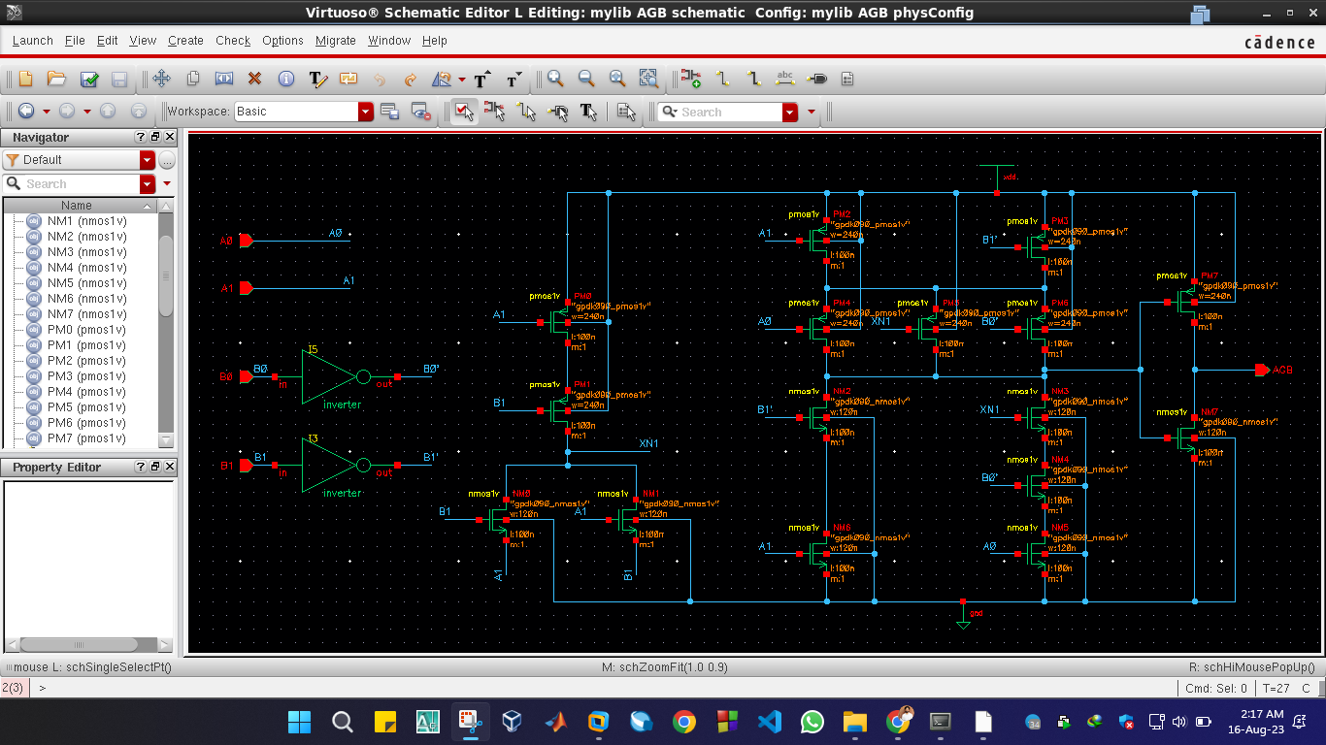
A is greater than B
Schematic

Slide 8
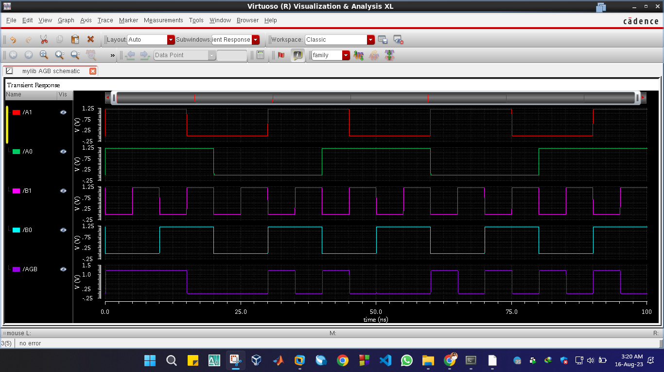
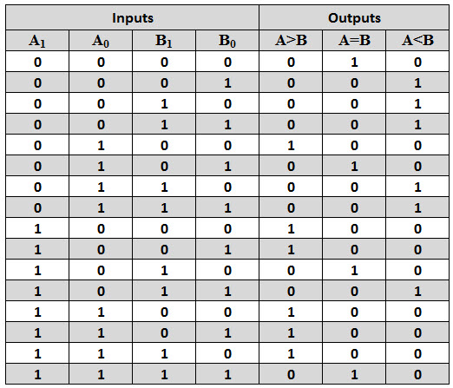
A is greater than B
Input & Output Waveform with Truth Table

Slide 9
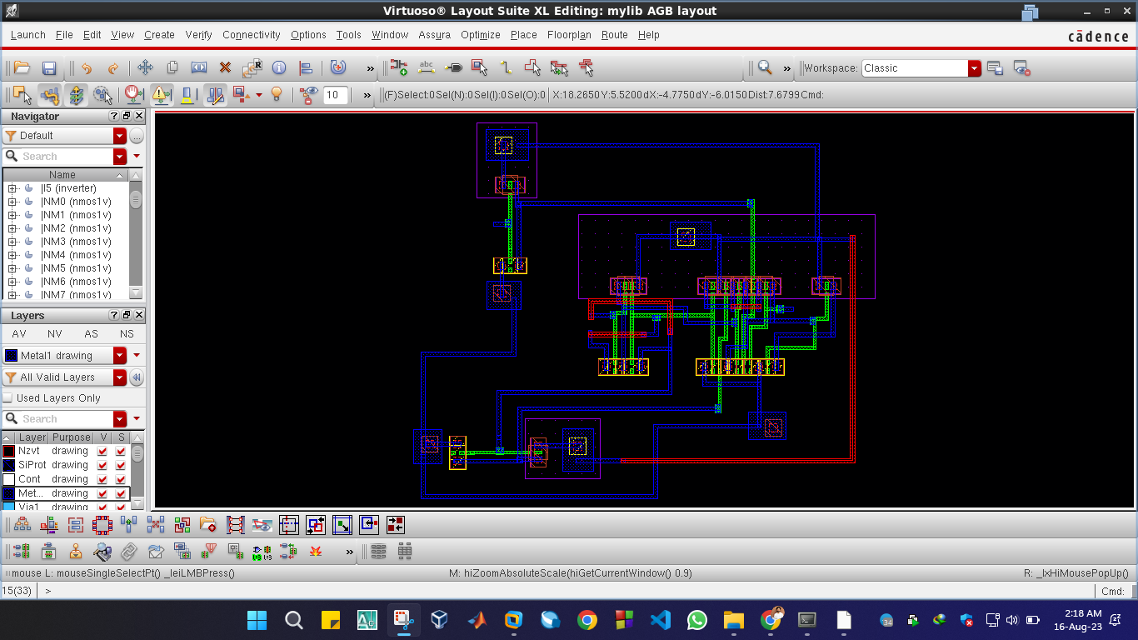
A is greater than B
Layout

Slide 10
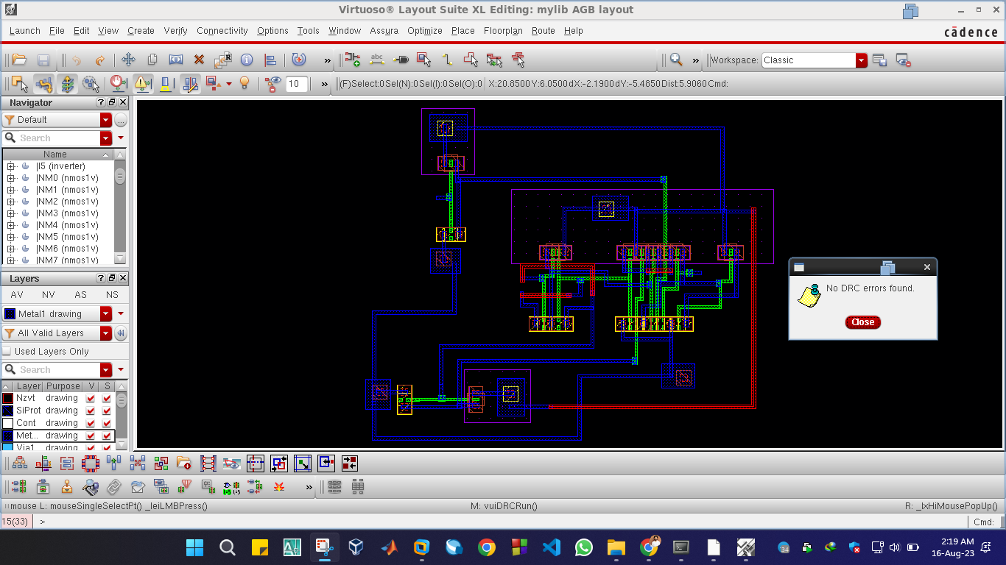
I A is greater than B
Layout with No DRC

Slide 11
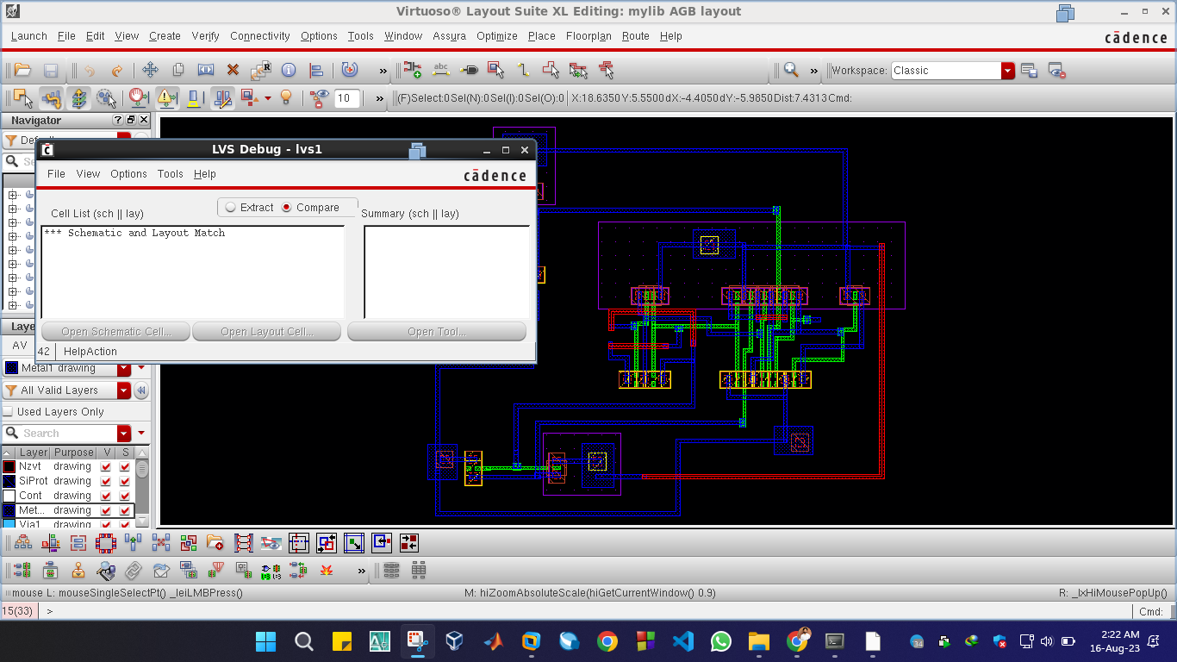
A is greater than B
Layout with No LVS mismatches

Slide 12
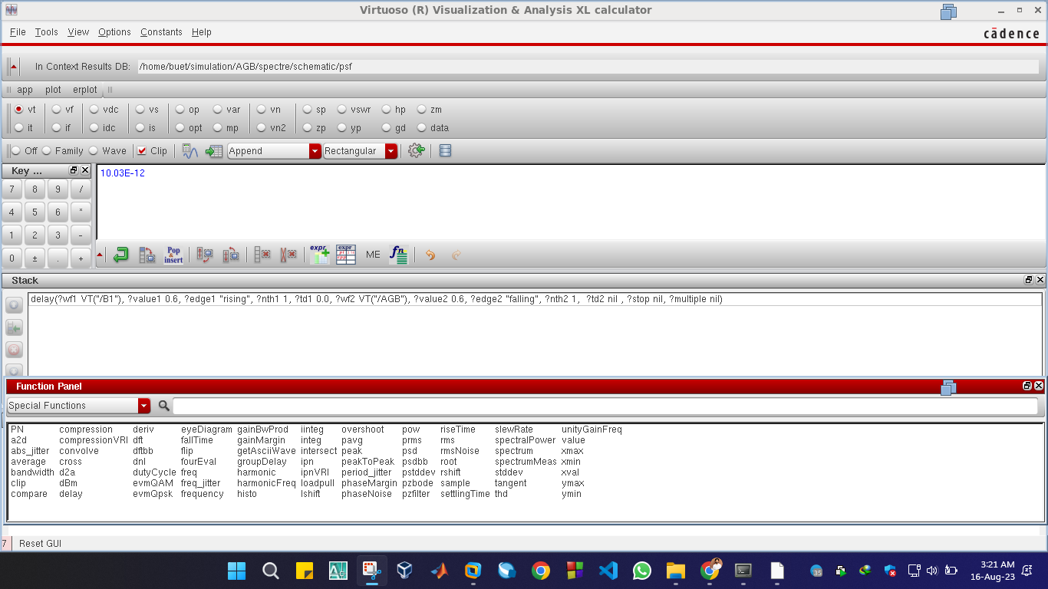
A is greater than B
Propagation Delay

Slide 13
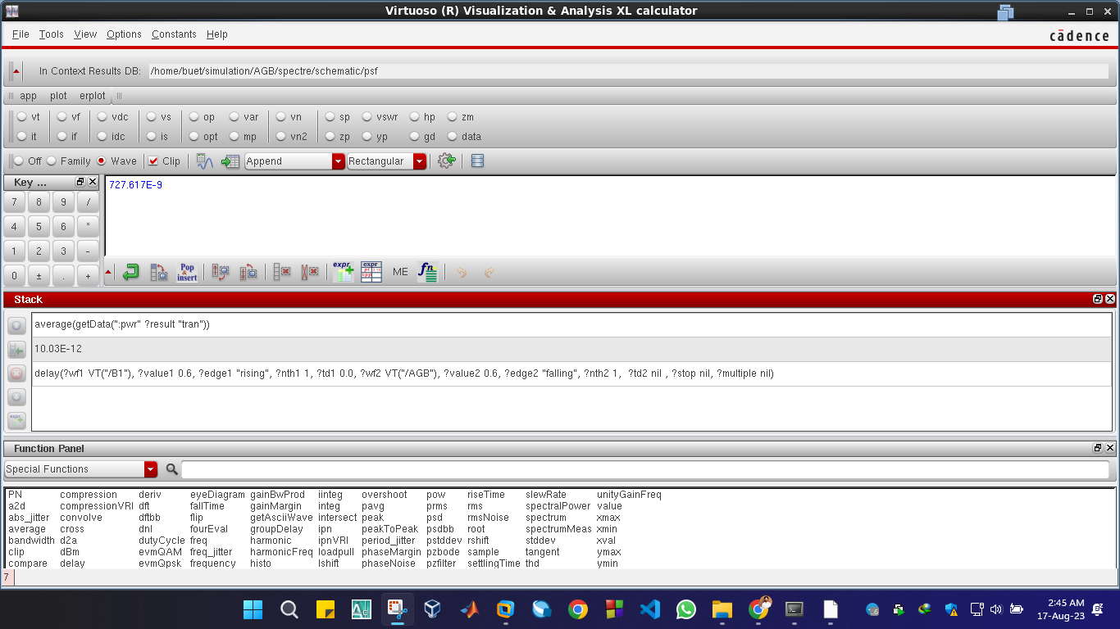
A is greater than B
Average Power

Slide 14
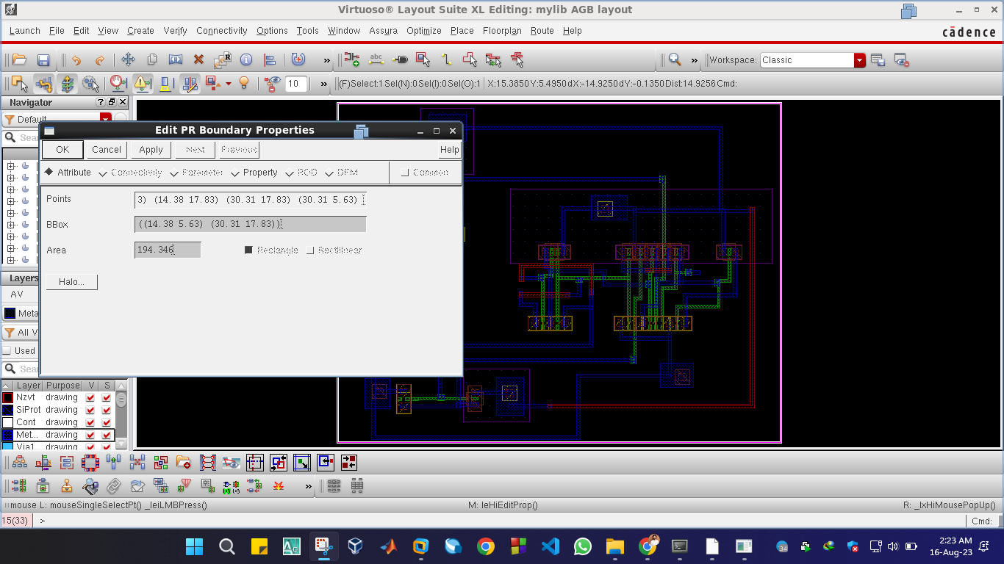
A is greater than B
Cell Area

Slide 15
Circuit-2
Circuit-2
A is equal to B
The circuit determines whether
two bits A & B is equal to or not.
If two bits are equal then 1 is shown in output. Otherwise it will show 0.

Slide 16
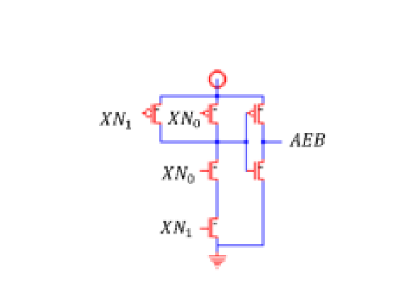
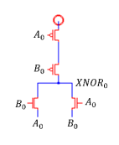
A is equal to B
Circuit Diagram

Slide 17
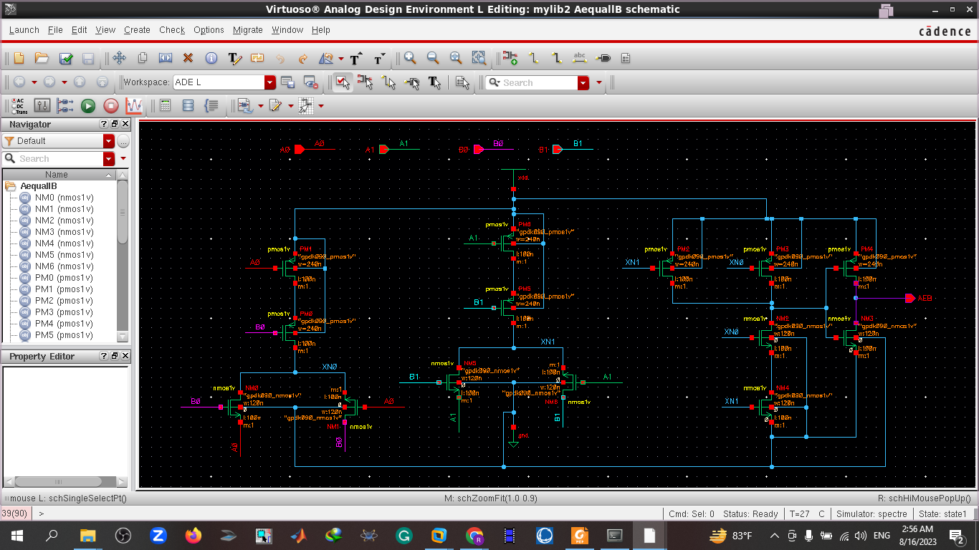
A is equal to B
Schematic

Slide 18
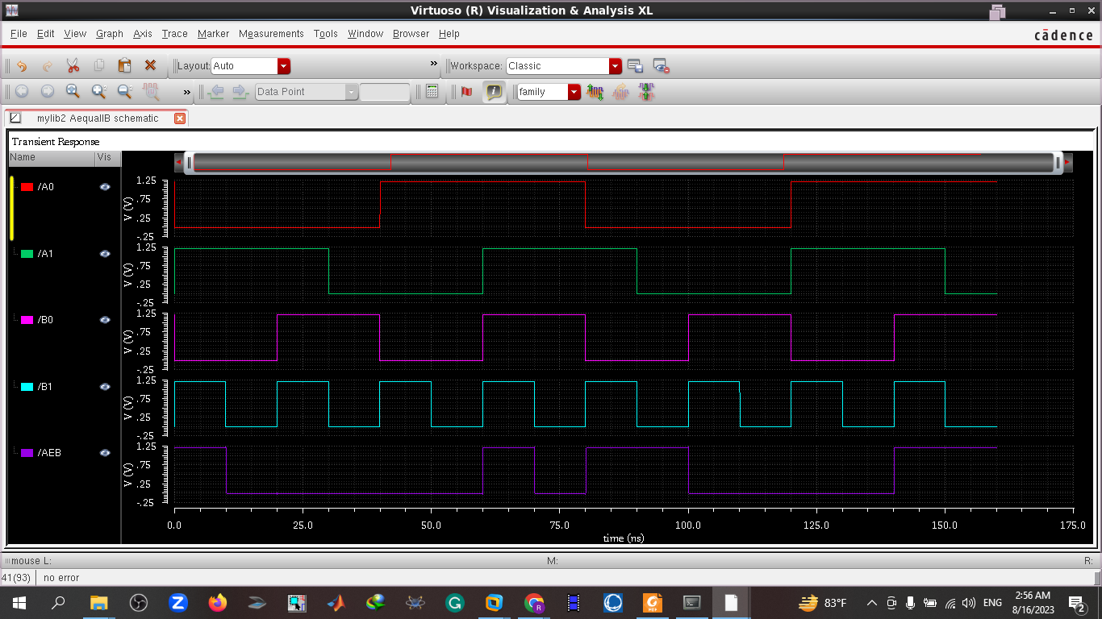
A is equal to B
Input & Output Waveform with Truth Table

Slide 19
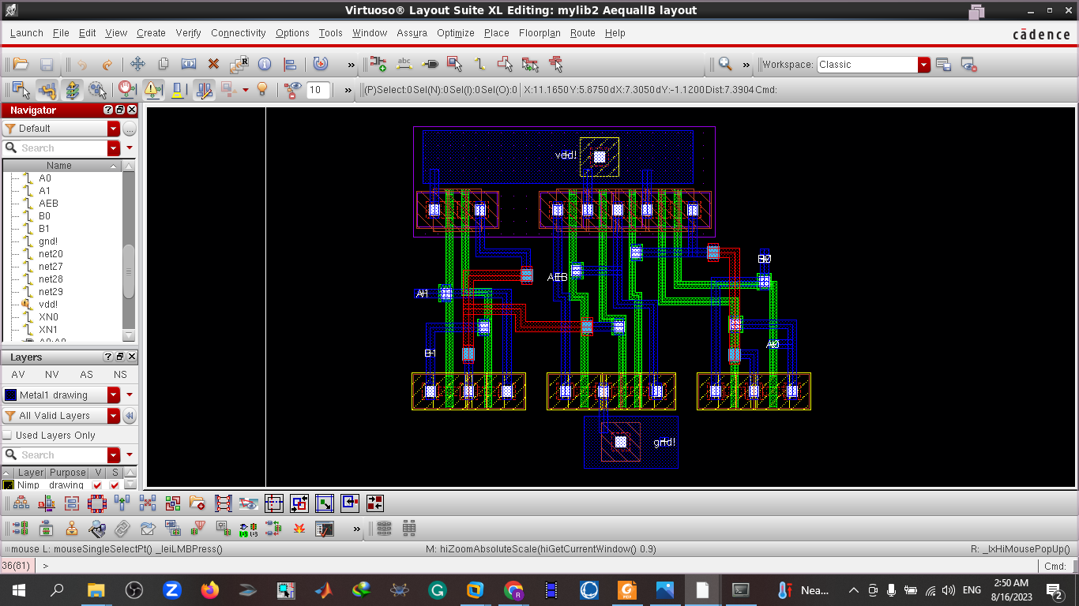
A is equal to B
Layout

Slide 20
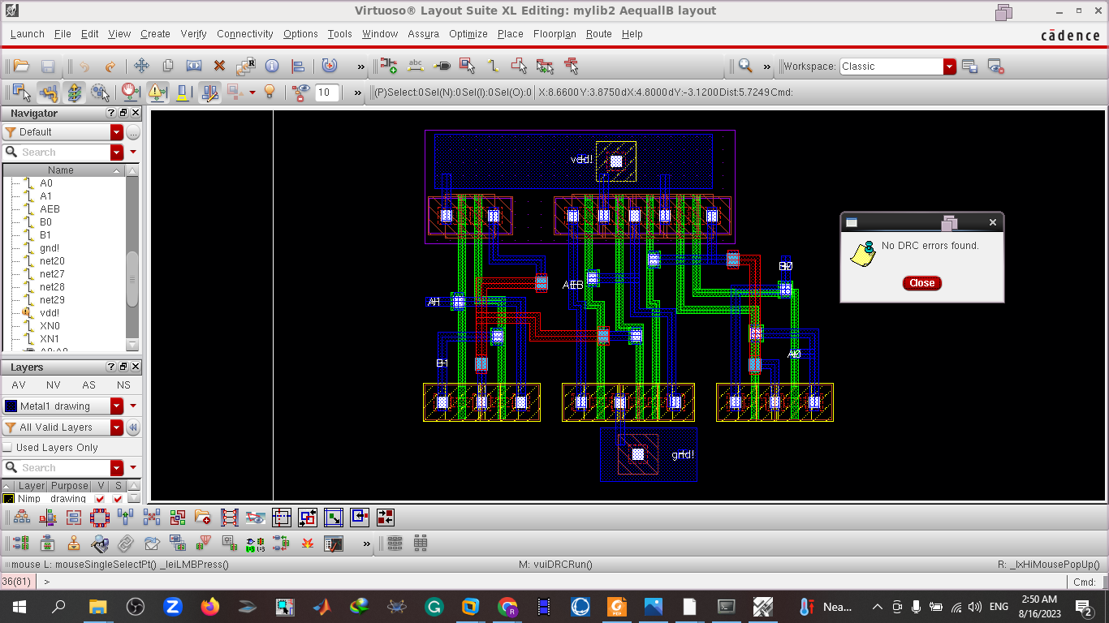
A is equal to B
Layout with No DRC Error

Slide 21
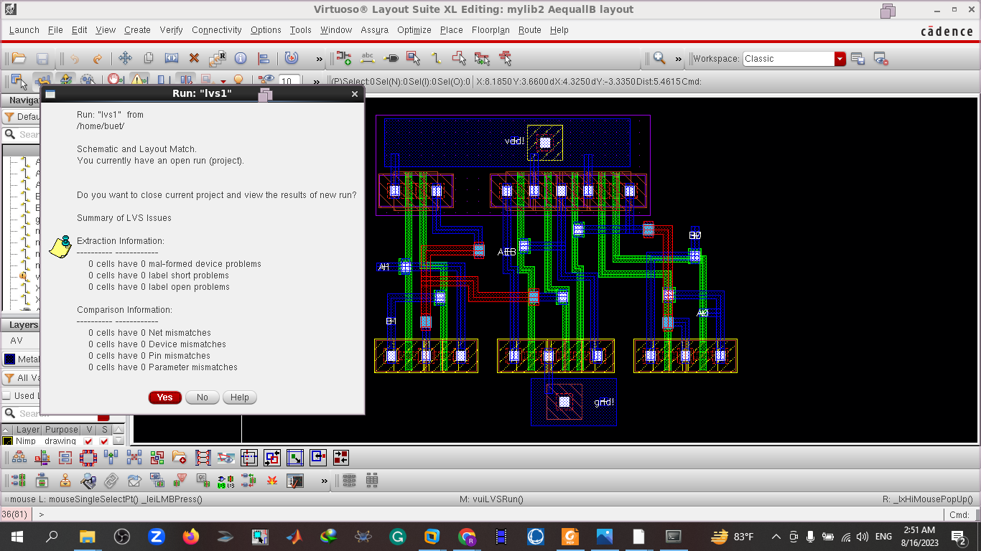
A is equal to B
LVS

Slide 22
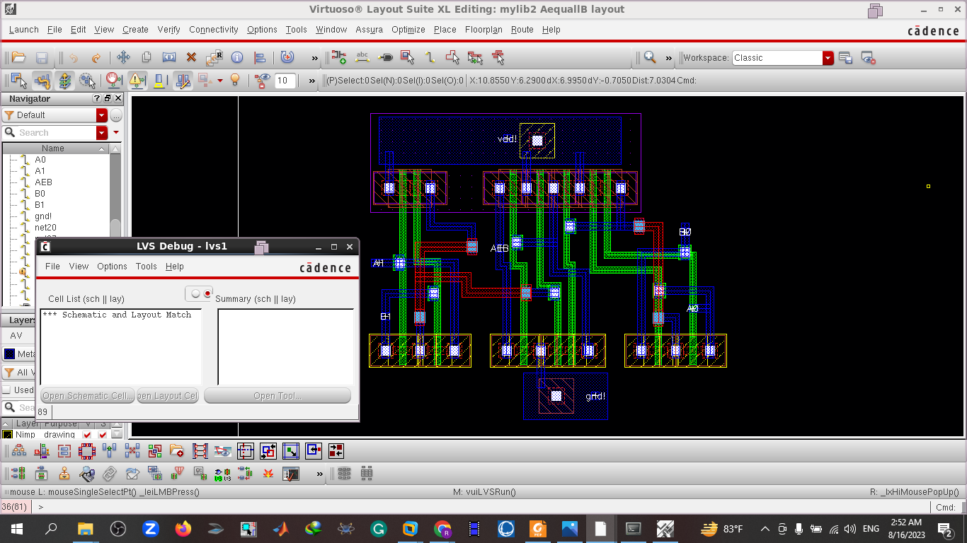
A is equal to B
No LVS Mismatch:

Slide 23
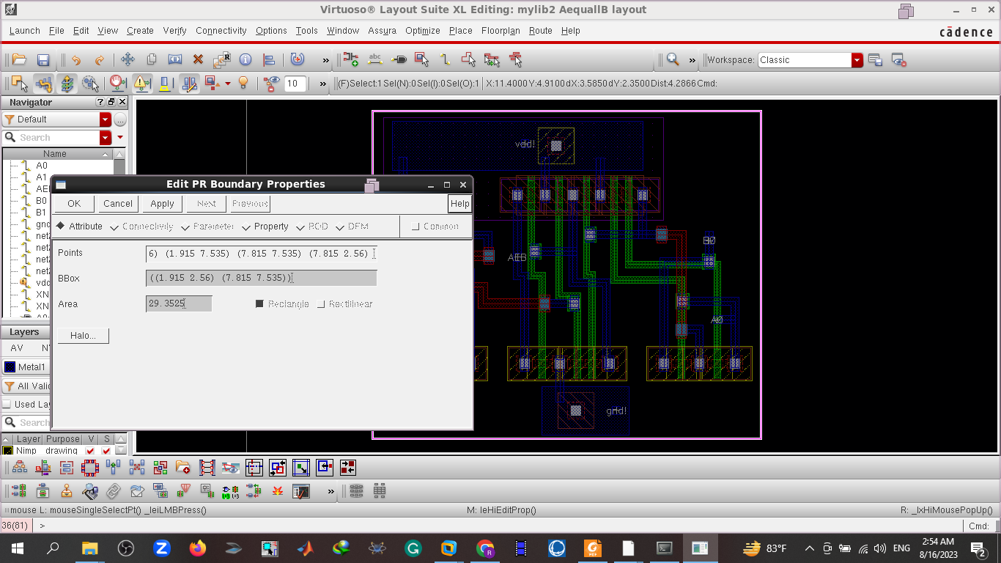
A is equal to B
Cell Area:

Slide 24
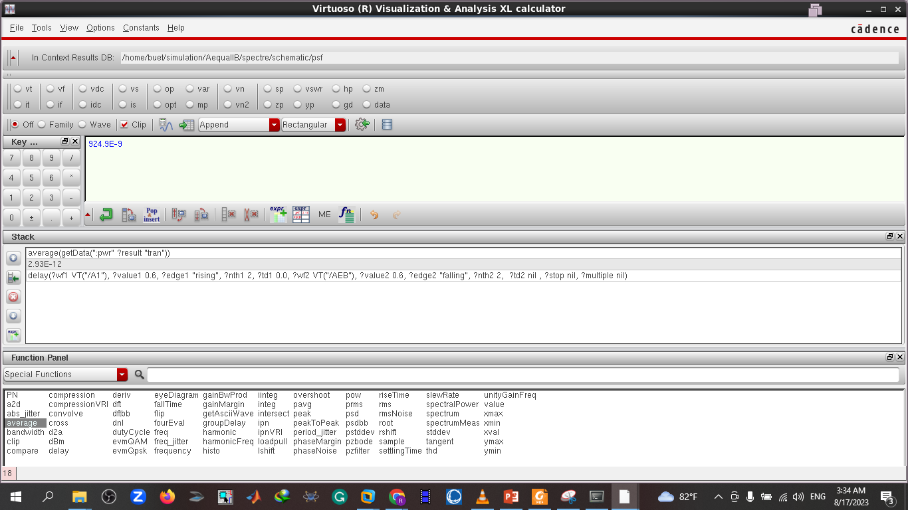
A is equal to B
Power

Slide 25
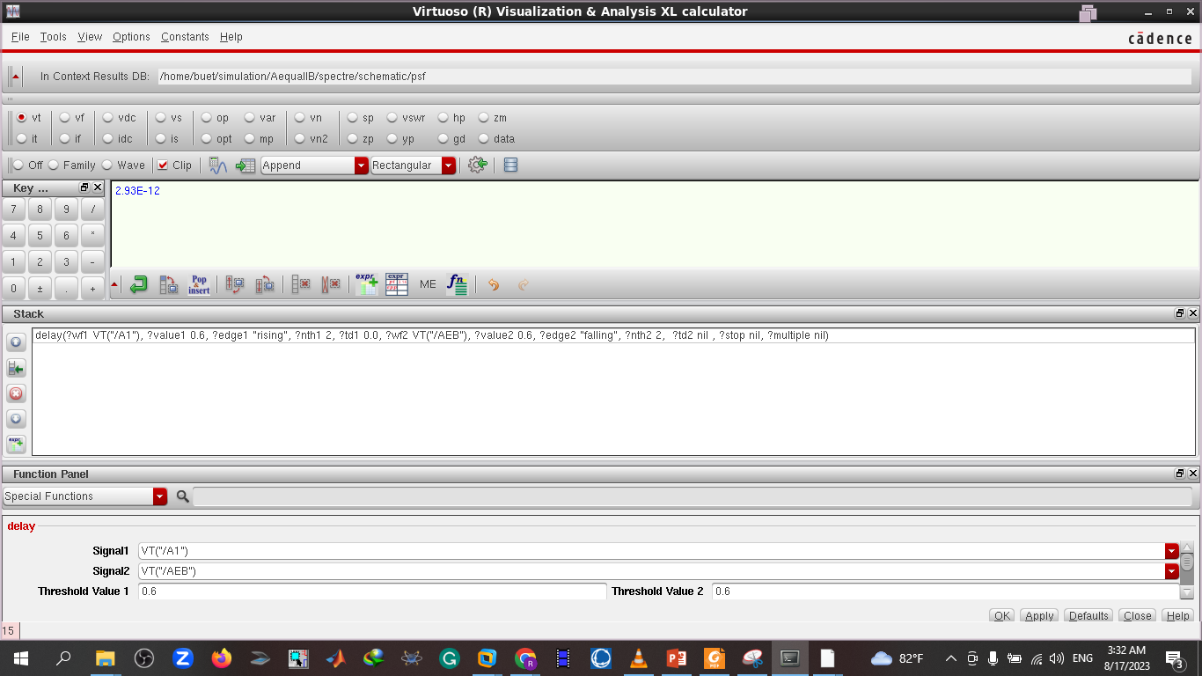
A is equal to B
Delay

Slide 26
Circuit-3
Circuit-3
A is less than B
The circuit does the job of computing whether A is less than B or not.
If A is less than B then it will show 1 in output otherwise it will show 0

Slide 27
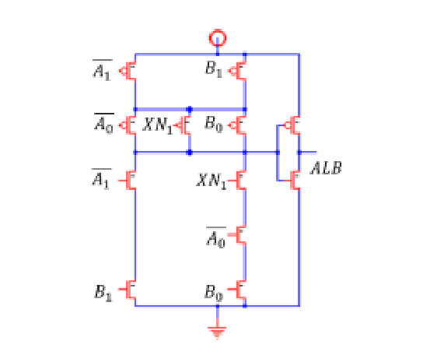
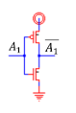
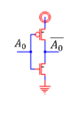
A is less than B
Circuit Diagram
27

Slide 28
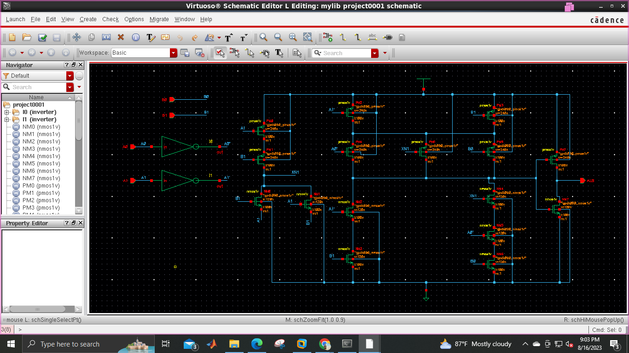
A is less than B
Schematic

Slide 29
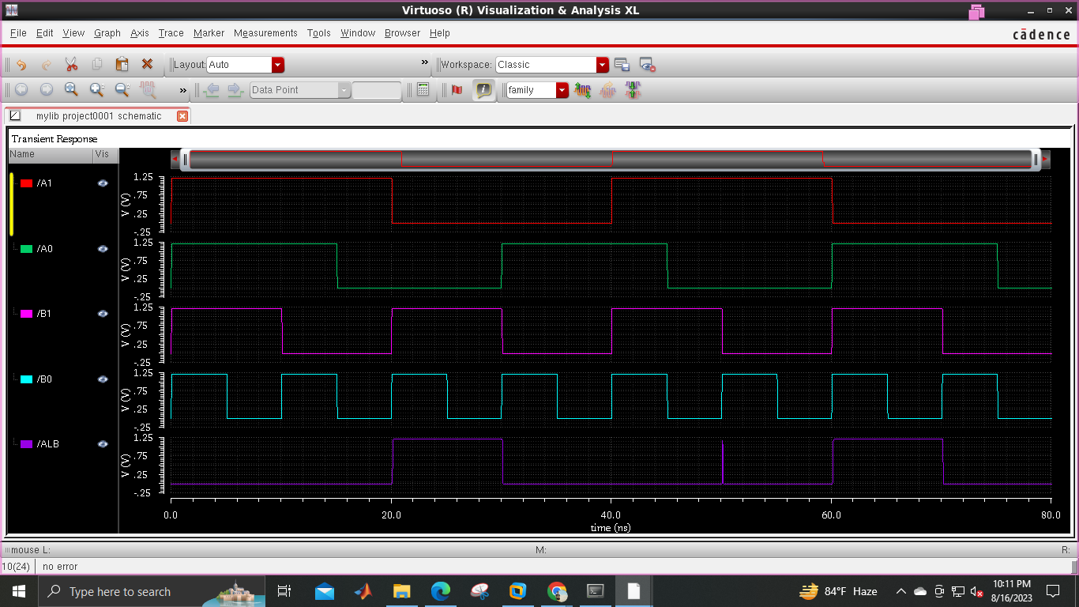
A is less than B
Output with truth table

Slide 30
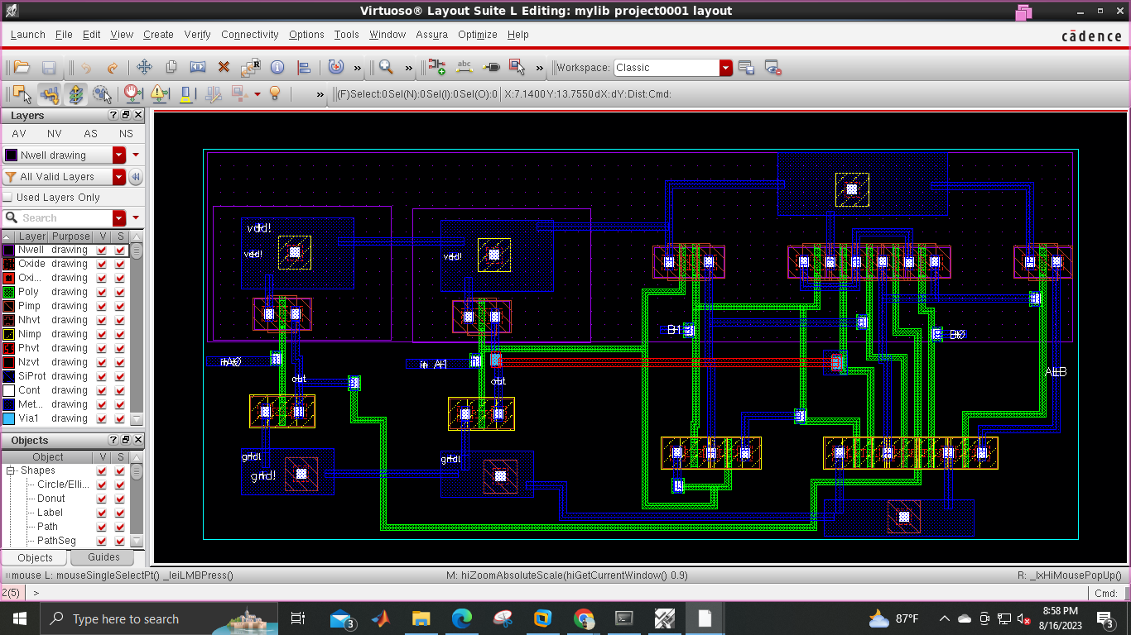
A is less than B
Layout

Slide 31
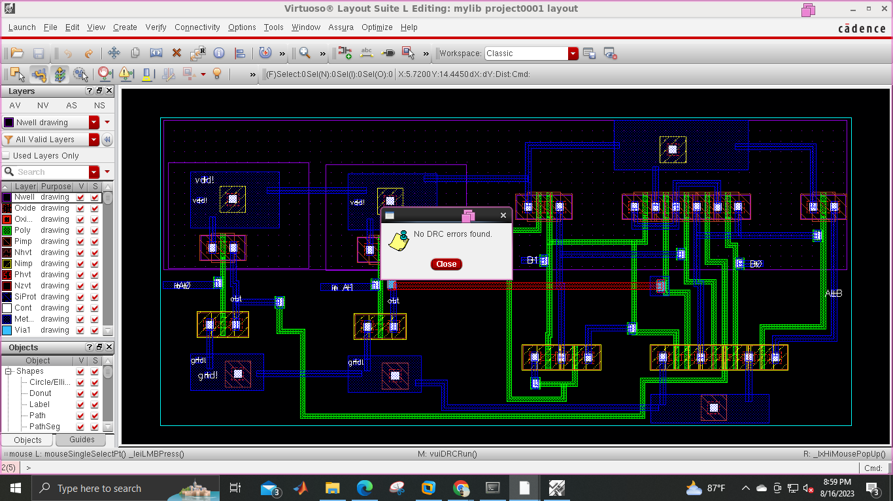
IA is less than B
No DRC Error

Slide 32
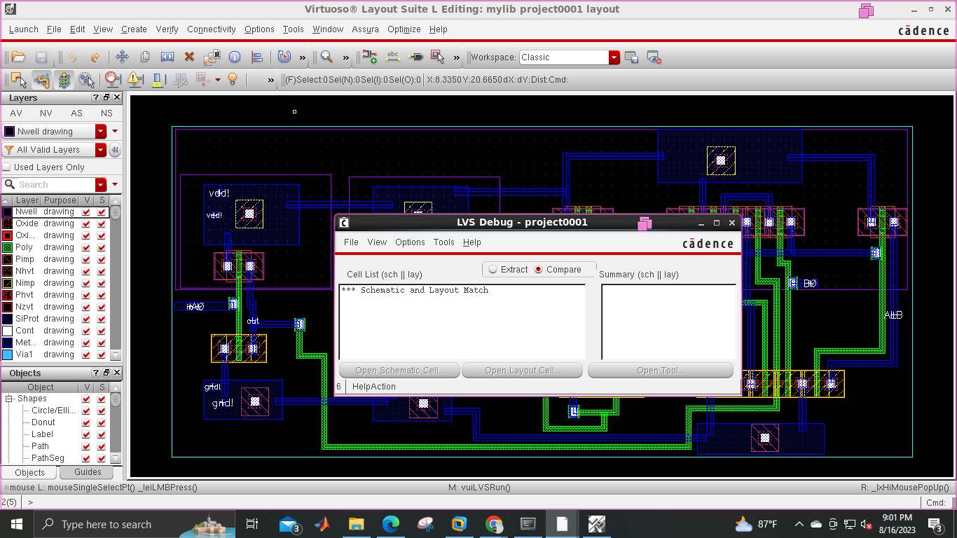
IA is less than B
LVS

Slide 33
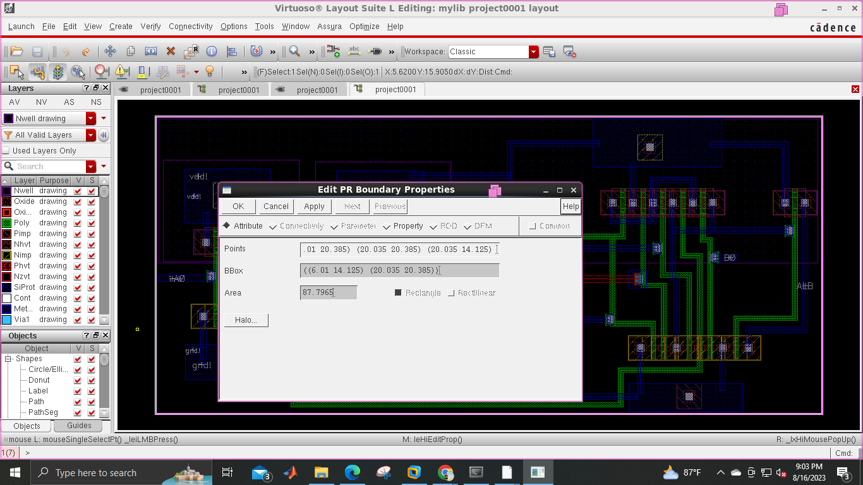
A is less than B
Area

Slide 34
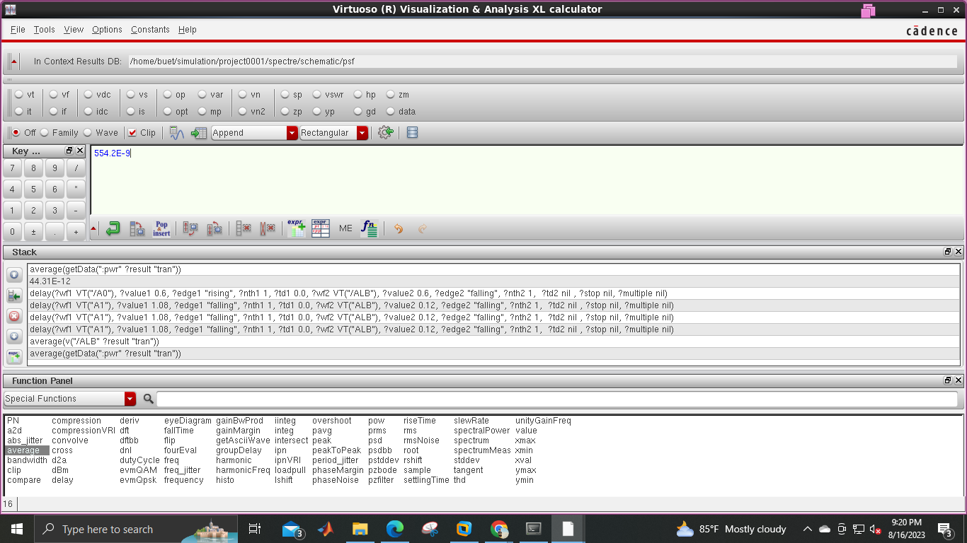
A is less than B
Power

Slide 35
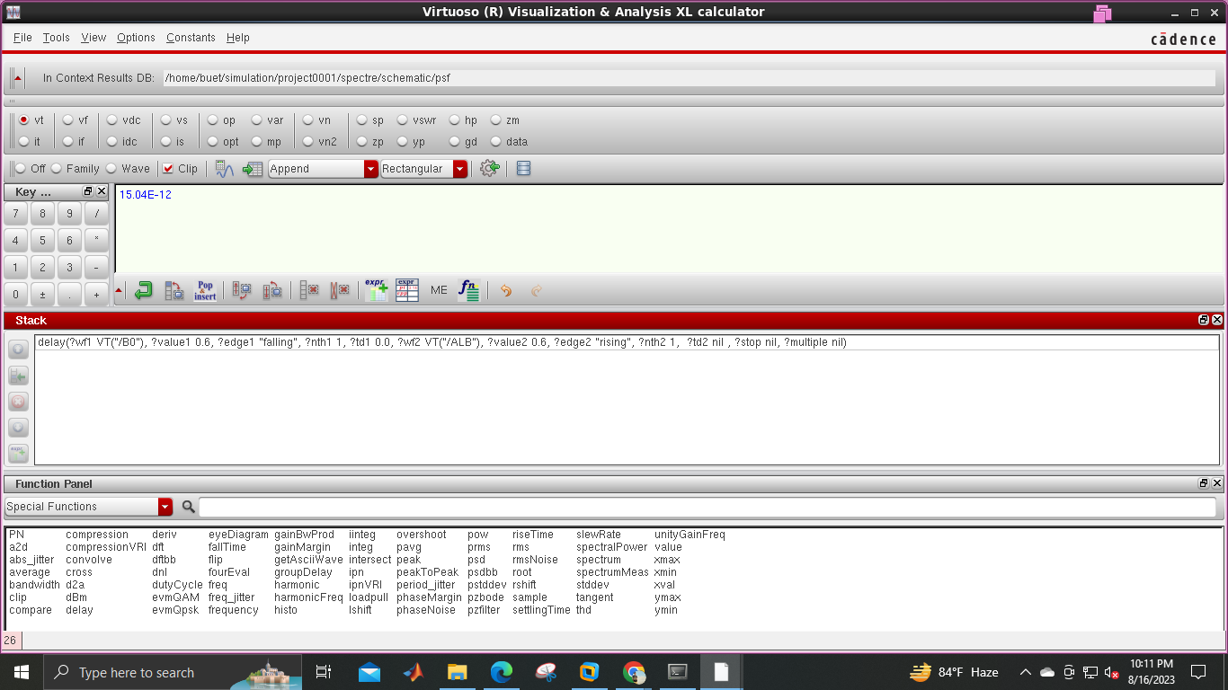
A is less than B
Delay

Slide 36
Comparison between the Comparators
Comparison Table Using obtained Data
Circuit | Propagation Delay (pS) | Average Power (µW) | Power Delay Product | Cell Area (µm²) | No. of Transistors | No. of DRC Errors | No. of LVS Mismatches
A˃B | 10.03 | 727.6 | 7297.828 | 194.346 | 20 | 0 | 0
A=B | 2.93 | 934.9 | 2739.257 | 29.3525 | 14 | 0 | 0
A<B | 15.04 | 554.2 | 8335.168 | 87.7965 | 20 | 0 | 0

Slide 37
The End
Thank you all

